Slide 1

Spatio-Temporal Logic Guided Optimization for Collective Adaptive Systems
UNIVERSITY OF TRIESTE
Department of Mathematics, Informatics and Geosciences
Master’s Degree in
Data Science & Artificial Intelligence
Candidate
Annalisa Paladino
Supervisor
Prof. Francesca Cairoli
A.Y. 2024/2025

Slide 2
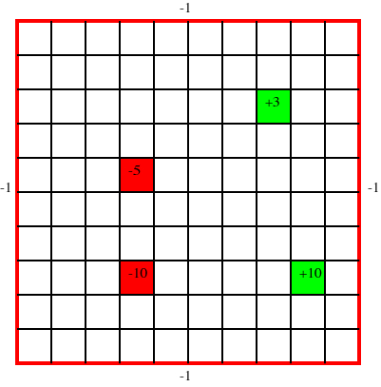
Introduction
Collective Adaptive Systems (CAS): Large-scale networks of autonomous agents (e.g., drone swarms) operating in dynamic, uncertain environments
Challenge: Traditional Reinforcement Learning (RL) relies on Reward Shaping:
- Manual & Error-prone: Hard to design for complex behaviors
- Opaque: Lacks formal guarantees or interpretability
Formal Methods improve Traditional RL
How? Use STREL (Spatio-Temporal Reach and Escape Logic) as Reward Function

Slide 3
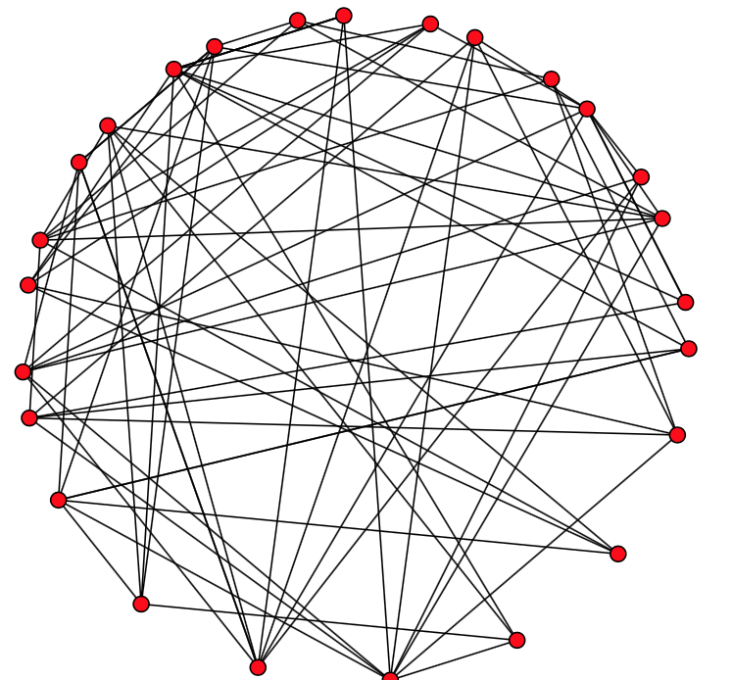
Spatio-Temporal Reach and Escape Logic STREL
STREL: a formal logic used to specify and verify the behavior of distributed systems evolving over both time and space
The system is modeled as a dynamic weighted graph:
nodes represent agents or locations
edges represent interactions, proximity, or connectivity
Semantics:
Boolean: tells whether a formula is true or false
Quantitative: measures how strongly a property is satisfied or violated through robustness

Slide 4
Syntax
STREL combines: logical, temporal operators and spatial operators
STREL
STL

Slide 5
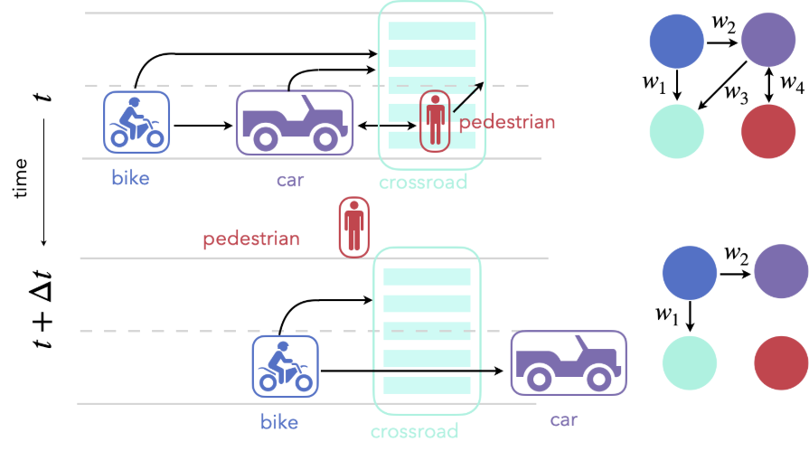
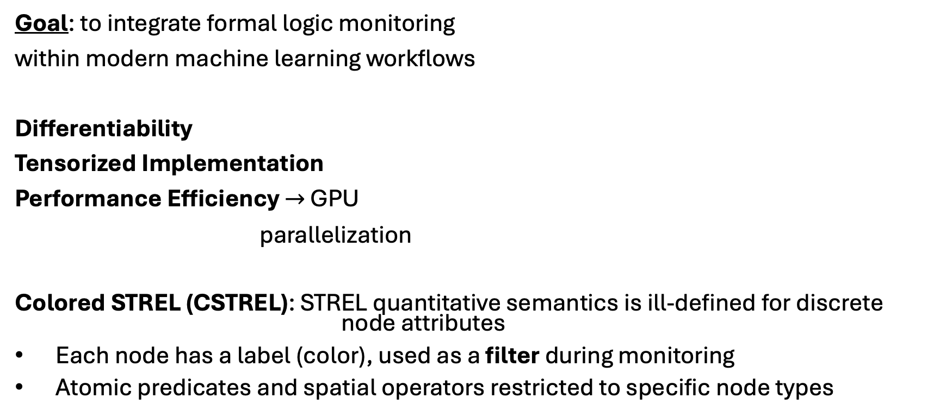
A Differentiable STREL Library
Goal: to integrate formal logic monitoring
within modern machine learning workflows
Differentiability $→$ PyTorch
Tensorized Implementation $→$ PyTorch
Performance Efficiency $→$ GPU
parallelization
Colored STREL (CSTREL): STREL quantitative semantics is ill-defined for discrete node attributes
Each node has a label (color), used as a filter during monitoring
Atomic predicates and spatial operators restricted to specific node types
PyTorch
Notes:
Abbiamo uno scenario con più agenti, così avremo variabili continue e variabili categoriche come tipo di agenti

Slide 6
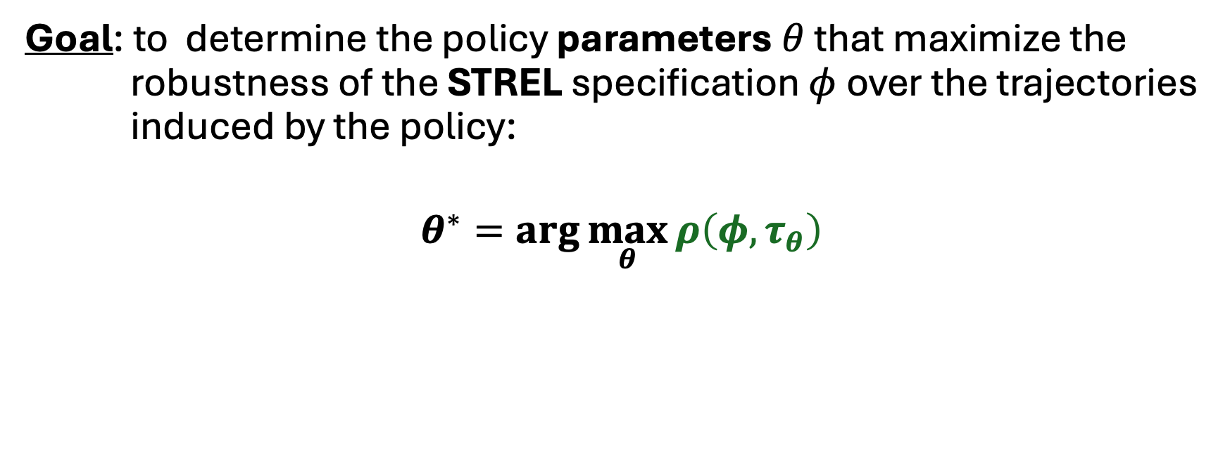
Policy Optimization
CSTREL for task specification Policy Optimization
Goal: to determine the policy parameters $θ$ that maximize the robustness of the STREL specification $φ$over the trajectories induced by the policy:
$$θ^{∗}=arg\max_{θ}{ρ\left(φ, τ_{θ}\right)}$$
$ρ\left(φ, τ_{θ}\right)$: quantitative robustness of trajectory $τ$ with respect to $φ$
Notes:
Facciamo task specification tramite CSTREL e questa task specification diventa la funzione obbietivo per fare policy optimization (specifica che usiamo la semantica quantitativa)

Slide 7
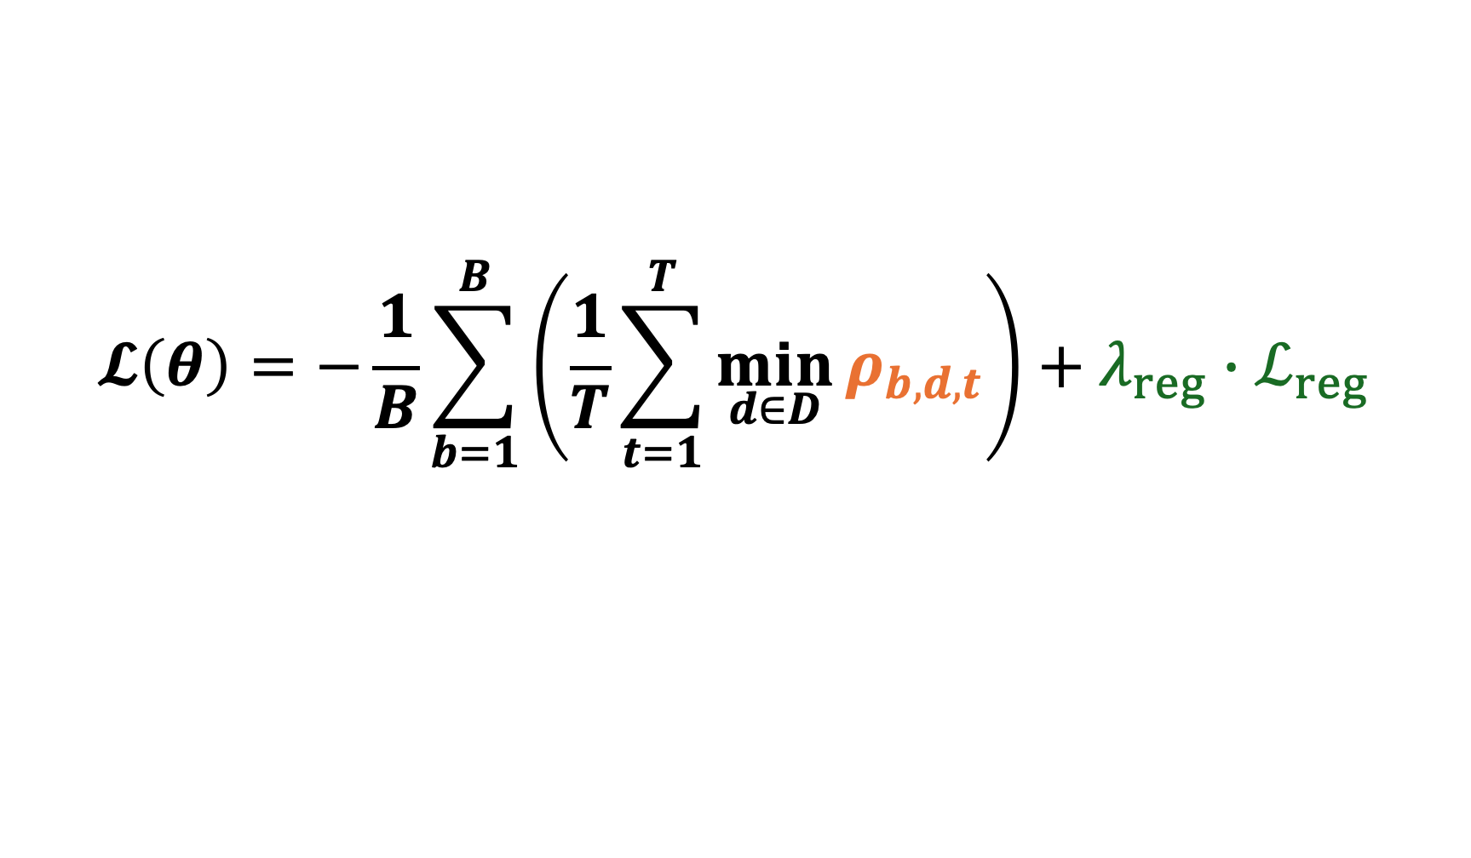
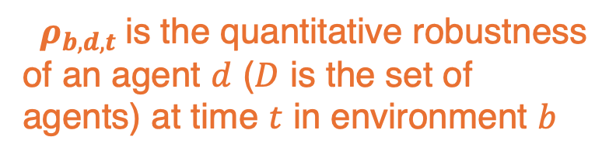
Reward Shaping
$$𝓛\left(θ\right)=−\frac{1}{B}\sum_{b=1}^{B}{\left(\frac{1}{T}\sum_{t=1}^{T}{\min_{d∈D}{ρ_{b, d, t}}}\right)+λ_{reg}{∙ℒ}_{reg}}$$
Regularization term on actions
$ρ_{b, d, t}$is the quantitative robustness of an agent $d$ ($D$ is the set of agents) at time $t$ in environment $b$
Minimizing this term is equivalent to maximizing the STREL robustness
Notes:
The loss is driven by the worst-performing agent at each time step; the temporal average then encourages robust behavior throughout the whole trajectory

Slide 8
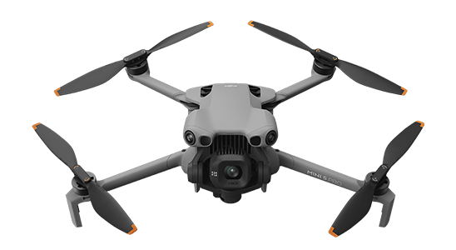
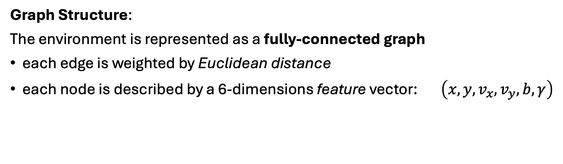
Experimentals Setup
A group of simulated battery-powered drones navigates in an area and need to accomplish some specific tasks
Graph Structure:
The environment is represented as a fully-connected graph
each edge is weighted by Euclidean distance
each node is described by a 6-dimensions feature vector: $\left(x, y, v_{x}, v_{y}, b, γ\right)$
node position

Slide 9
Experimentals Setup
A group of simulated battery-powered drones navigates in an area and need to accomplish some specific tasks
Graph Structure:
The environment is represented as a fully-connected graph
each edge is weighted by Euclidean distance
each node is described by a 6-dimensions feature vector: $\left(x, y, v_{x}, v_{y}, b, γ\right)$
velocity

Slide 10
Experimentals Setup
A group of simulated battery-powered drones navigates in an area and need to accomplish some specific tasks
Graph Structure:
The environment is represented as a fully-connected graph
each edge is weighted by Euclidean distance
each node is described by a 6-dimensions feature vector: $\left(x, y, v_{x}, v_{y}, b, γ\right)$
battery level

Slide 11
Experimentals Setup
A group of simulated battery-powered drones navigates in an area and need to accomplish some specific tasks
Graph Structure:
The environment is represented as a fully-connected graph
each edge is weighted by Euclidean distance
each node is described by a 6-dimensions feature vector: $\left(x, y, v_{x}, v_{y}, b, γ\right)$
node type label (CSTREL)

Slide 12
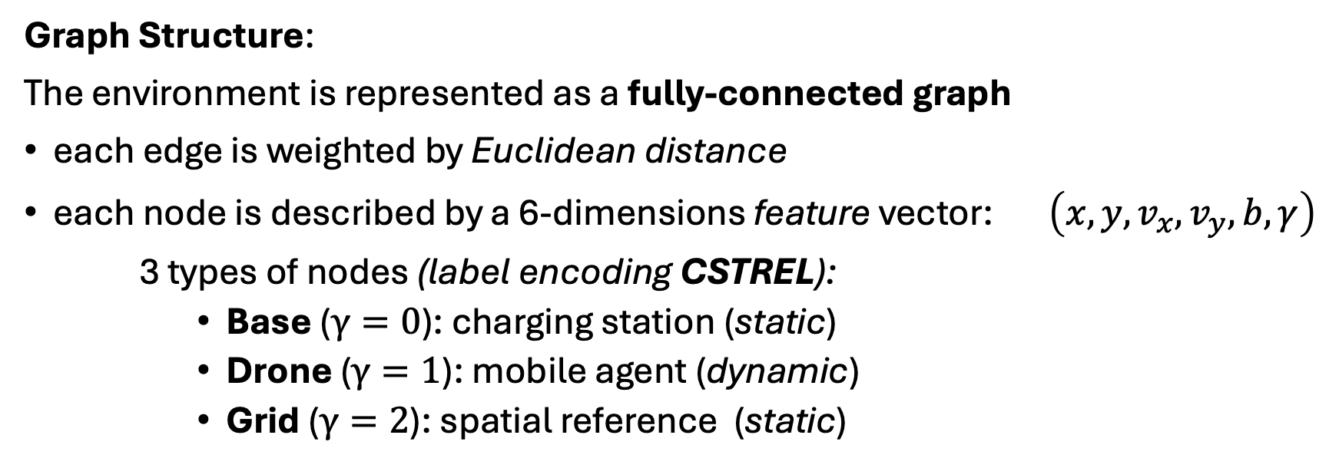
Experimentals Setup
A group of simulated battery-powered drones navigates in an area and need to accomplish some specific tasks
Graph Structure:
The environment is represented as a fully-connected graph
each edge is weighted by Euclidean distance
each node is described by a 6-dimensions feature vector: $\left(x, y, v_{x}, v_{y}, b, γ\right)$
3 types of nodes (label encoding CSTREL):
Base ($γ=0$): charging station (static)
Drone ($γ=1$): mobile agent (dynamic)
Grid ($γ=2$): spatial reference (static)

Slide 13
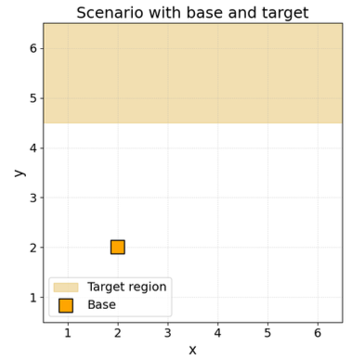
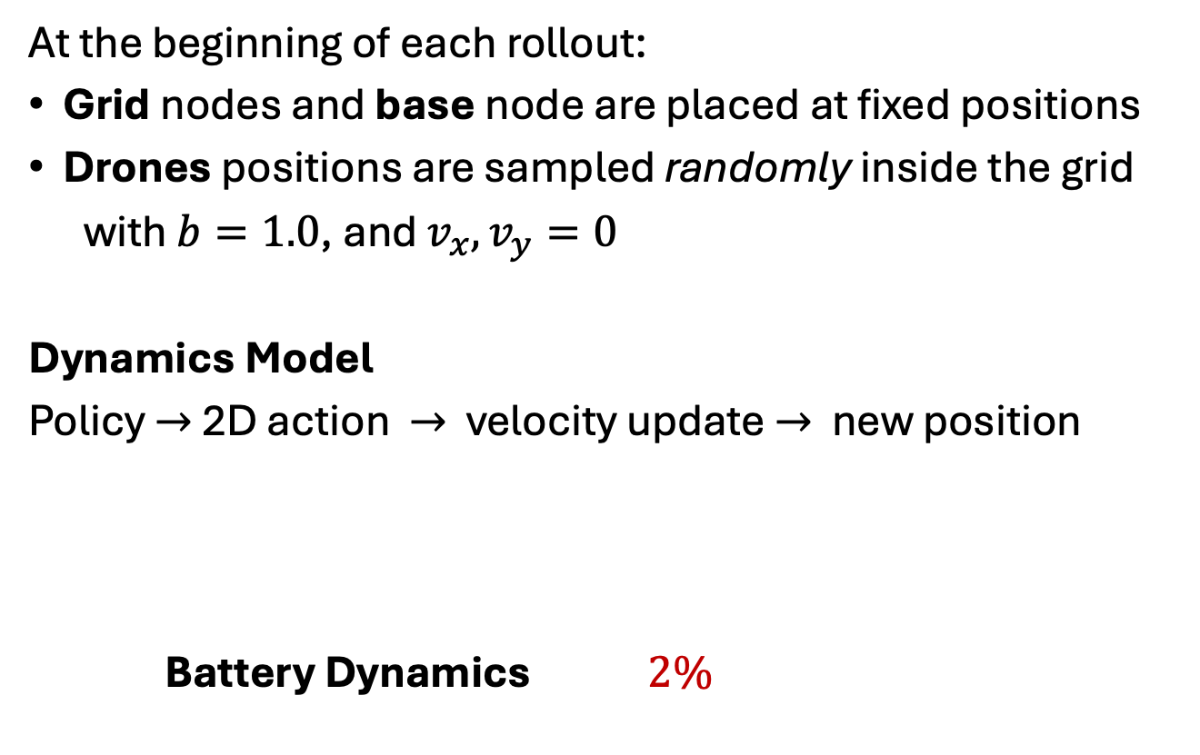
Initialization
At the beginning of each rollout:
Grid nodes and base node are placed at fixed positions
Drones positions are sampled randomly inside the grid
with $b=1.0$, and $v_{x}, v_{y}=0$
Dynamics Model
Policy $→$ 2D action $→$ velocity update $→$ new position
Battery Dynamics $2\%$ $10\%$
Drone motion is continuous, bounded to the spatial domain, and smoothed by inertia
Notes:
Dynamics Model: at each time step, the policy produces a two-dimensional action for each drone. This action is combined with the previous velocity through a momentum term and then the position is updated according to the new velocity
Ricorda di dire che ho una policy comune per tutti gli agenti

Slide 14
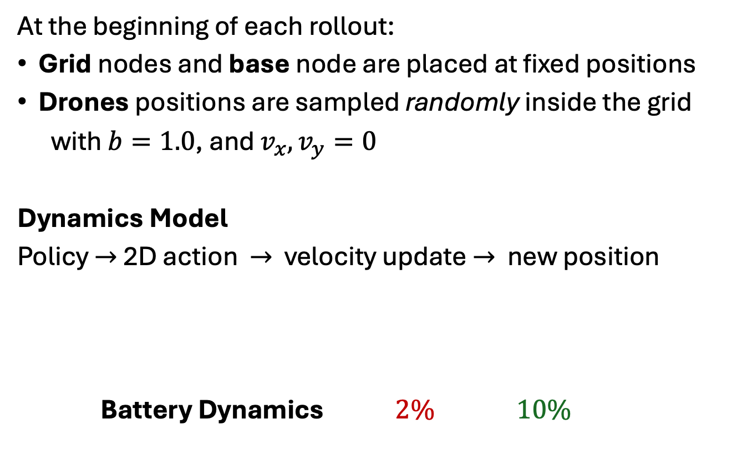
Initialization
At the beginning of each rollout:
Grid nodes and base node are placed at fixed positions
Drones positions are sampled randomly inside the grid
with $b=1.0$, and $v_{x}, v_{y}=0$
Dynamics Model
Policy $→$ 2D action $→$ velocity update $→$ new position
Battery Dynamics $2\%$ $10\%$
Drone motion is continuous, bounded to the spatial domain, and smoothed by inertia

Slide 15

Battery Recharge - No Collision
Drone nodes
Grid nodes
Base node
If a drone has high battery, it should reach the target region within a given time horizon
$$φ_{1}=high_battery⇒ F_{[0, t]}\left({alive Reach}_{[d_{1}, d_{2}]} at_target\right)$$
If a drone has low battery, it should reach a charging base and remain there until sufficiently recharged
$$φ_{2}=low_battery⇒ F_{[0, t]}\left(full_battery U ({alive Reach}_{\left[d_{1}, d_{2}\right]}free_base)\right)$$
A drone should remain alive at all times, meaning keep the battery level non-negative
$$φ_{3}=alive$$
Notes:
Usa le parole chiavi, leggi proprio come leggeresti la formula, se batteria è alta succederà che ad un certo punto il drone raggiungerà il target rimanendo vivo.
Specifica che queste formule sono molto semplici da leggere però la logica formale è in grado di imporre le proprietà desiderate

Slide 16
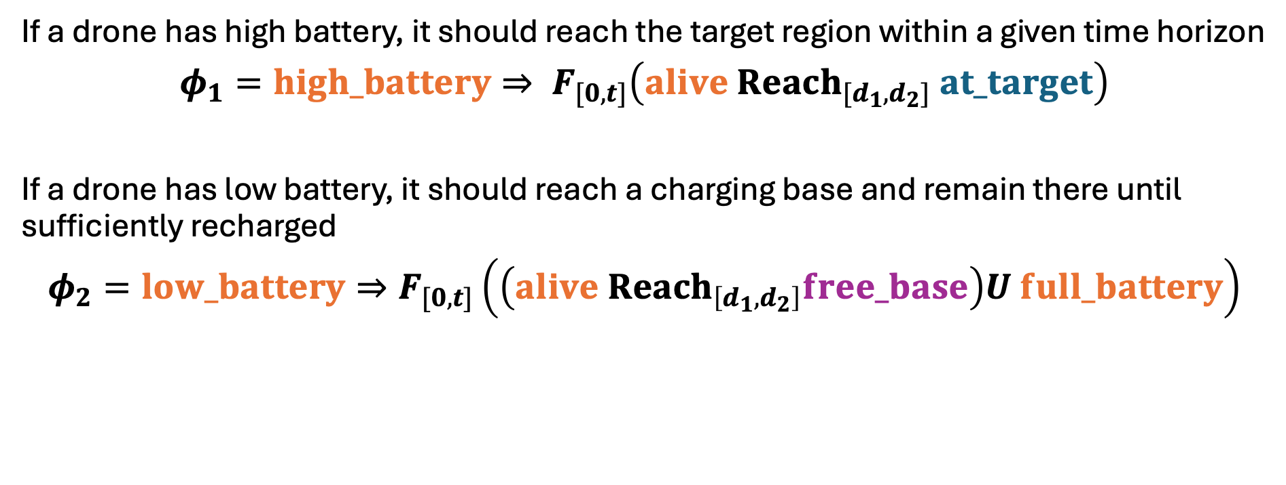
Battery Recharge - No Collision
Drone nodes
Grid nodes
Base node
If a drone has high battery, it should reach the target region within a given time horizon
$$φ_{1}=high_battery⇒ F_{[0, t]}\left({alive Reach}_{[d_{1}, d_{2}]} at_target\right)$$
If a drone has low battery, it should reach a charging base and remain there until sufficiently recharged
$$φ_{2}=low_battery⇒F_{[0, t]}\left(\left({alive Reach}_{\left[d_{1}, d_{2}\right]}free_base\right)U full_battery\right)$$
A drone should remain alive at all times, meaning keep the battery level non-negative
$$φ_{3}=alive$$
Notes:
Quando la batteria è bassa imponiamo che ad un certo punto raggiunga una base di ricarica libera finchè la batteria è carica

Slide 17
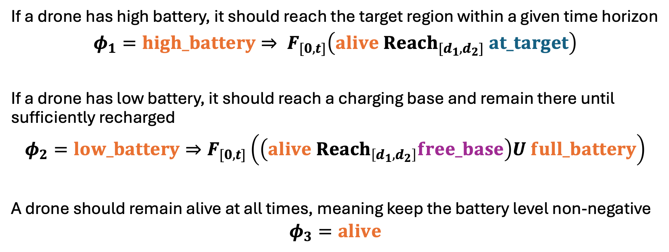

Battery Recharge - No Collision
Drone nodes
Grid nodes
Base node
If a drone has high battery, it should reach the target region within a given time horizon
$$φ_{1}=high_battery⇒ F_{[0, t]}\left({alive Reach}_{[d_{1}, d_{2}]} at_target\right)$$
If a drone has low battery, it should reach a charging base and remain there until sufficiently recharged
$$φ_{2}=low_battery⇒F_{[0, t]}\left(\left({alive Reach}_{\left[d_{1}, d_{2}\right]}free_base\right)U full_battery\right)$$
A drone should remain alive at all times, meaning keep the battery level non-negative
$$φ_{3}=alive$$
$alive$: atomic predicate restricted to drone nodes with
$battery>0.05$

Slide 18

Battery Recharge - No Collision
Drone nodes
Grid nodes
Base node
If a drone has high battery, it should reach the target region within a given time horizon
$$φ_{1}=high_battery⇒ F_{[0, t]}\left({alive Reach}_{[d_{1}, d_{2}]} at_target\right)$$
If a drone has low battery, it should reach a charging base and remain there until sufficiently recharged
$$φ_{2}=low_battery⇒F_{[0, t]}\left(\left({alive Reach}_{\left[d_{1}, d_{2}\right]}free_base\right)U full_battery\right)$$
A drone should remain alive at all times, meaning keep the battery level non-negative
$$φ_{3}=alive$$
The drones should not be closer than $d_{safe}$
$$φ_{4}=\left\|p_{1}\left(t\right)−p_{2}(t)\right\|>d_{safe}$$

Slide 19
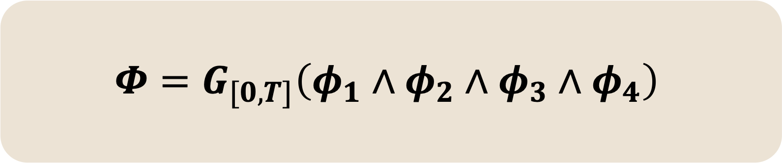
Battery Recharge - No Collision
$$Φ=G_{[0, T]}\left(φ_{1}∧φ_{2}∧φ_{3}∧φ_{4}\right)$$

Slide 20
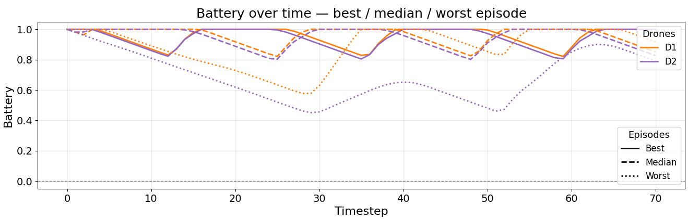
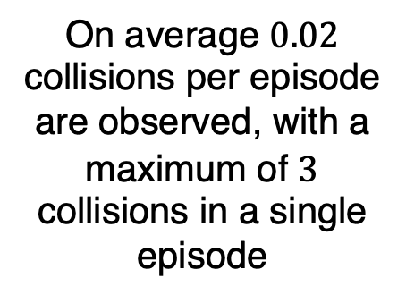
Battery Recharge - No Collision
On average $0.02$ collisions per episode are observed, with a maximum of $3$ collisions in a single episode
Notes:
Non commentare la batteria, dici per worst dici che hanno difficoltà a sincronizzarsi ma che il task ciò nonostante funziona bene e viene completato

Slide 21
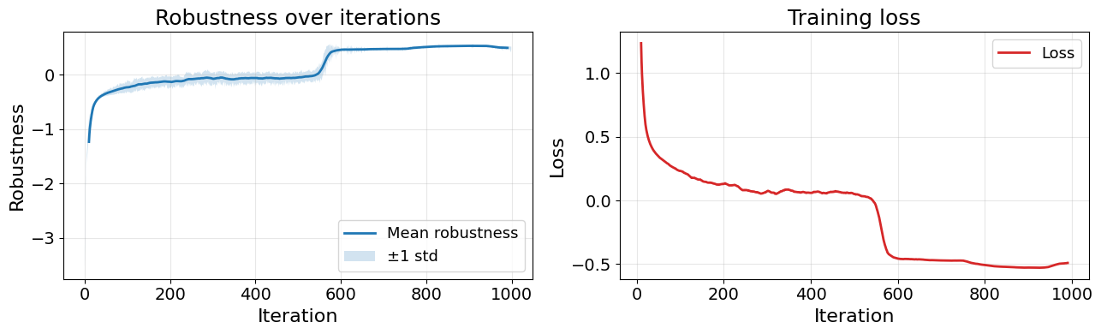
Battery Recharge - No Collision
Notes:
Qua velocissima, parla solo della robustezza

Slide 22
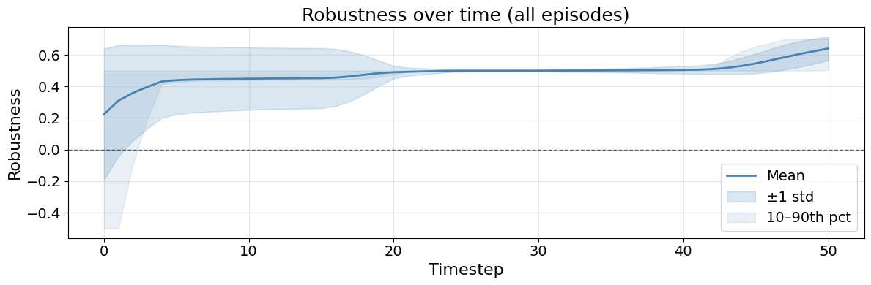
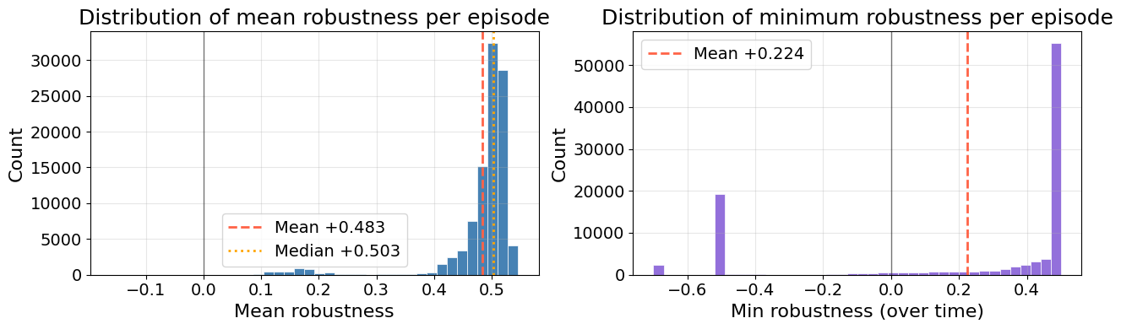
Battery Recharge - No Collision
Notes:
Per over time specifica bene che è over the trajectory, al posto di essere training iteration sono istanti della traiettoria
All’inizio essendo inizializzati random c’è un momento di coordinamento e per questo c’è una lieve negatività

Slide 23
Conclusions
Formal spatio-temporal logic can guide policy optimization in collective adaptive systems
STREL provides a natural way to encode mission, safety, and resource constraints
Differentiable robustness makes these specifications usable as a learning objective
Future works:
Extending the framework to larger graphs
Scaling to a higher number of agents

Slide 24
thank you for your attention!

